Slide 1



Flash Power on
15SS Fortuna

Slide 2
Project Chapter
Background
15SS Fortuna Price Reducing (<$11.00)
Simplify Design & Manufacturing Process with Flash Activator Machine for Assembly
Goals to Meet Fortuna 15SS FOB Price below than $11.00
Reduce Manpower
Increase productivity index output: PPH (prs/person/hour)
Reduce WIP in assembly process to get better quality
Deliverables
Time Line
Study & Analysis at Production
Start period : Mar 2013 (14SS)
End period : 15SS production

Slide 3
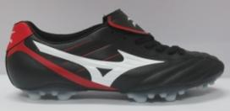

Project Planning
Step 1:
Bonding research on various applied cement condition on material surface
FORTUNA (Upper material PU Synt and Out sole material is TPU)
Step 2:
Bonding research related to life time of applied cement on bonding area then treat with flash activator
Bond reaction by flash activation after one day applied in IP starting from February-2013
Step 3:
Finalization process
Bonding flow process chart with flash activation
Production trial
Benefit implementation

Slide 4
Assembly Process Flow Chart
a. Current Assembly Line
BOTTOM
HEATER
CLEANING
HEATER
PRIMER
HEATER
CEMENT 1
HEATER
CEMENT 2
ATTACHING
UPPER
MARKING
PRIMER
CEMENT 1
CEMENT 2
b. Flash Power Line
FLASH ACTIVATOR
BOTTOM
CLEANING
PRIMERING
CEMENT
JET SET
ATTACHING
UPPER
MARKING

Slide 5
Man Power Plan on Flash Assembly (Reduce 7 person & Increase pph: 0.22)
1. CURRENT ASSEMBLY PROCES
Tower dryer
Vacuum
Upper & outsole Preparation
Setting upper & outsole
Upper marking
Check Upper to Sole
Cleaner outsole
Cleaner upper
Primer outsole
Primer upper
Heater conveyor
Total Man Power Cut to Box: 78 person, pph: 1,22
Attach Upper to Sole
Heater conveyor
Outsole Cement 2
Upper Cement 2
Heater Conveyor
Outsole Cement 1
Upper Cement 1
2. FLASH ASSEMBLY PROCES
Vacuum
Upper marking
Cleaner outsole
Cleaner upper
Primer outsole
Upper Cement 2
Sole Cement 2
Jet Setter
Attach L&R (2)
Total Man Power Cut to Box: 71, pph: 1,44

Slide 6
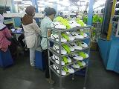
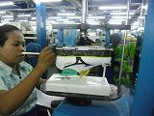
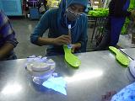
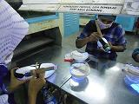
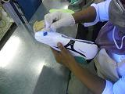
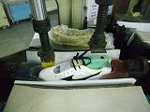
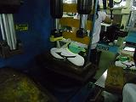
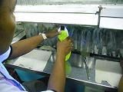
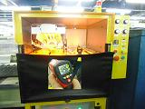
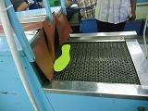
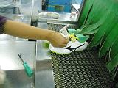
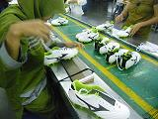
Flash Power Assembly
Vacuum
Upper marking
Cleaner outsole
Cleaner upper
Primer outsole
Upper Cement 2
Sole Cement 2
Jet Setter
Attach L&R (2)
Flash Power Setting:
Time to use: 3 Second/1pcs
Temperature Machine Room:96°C

Slide 7
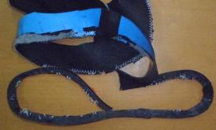
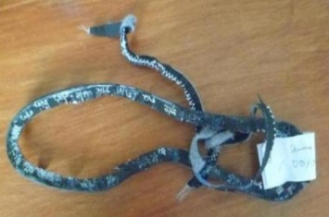
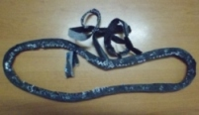
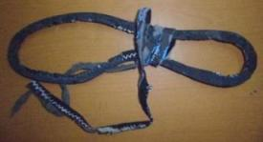
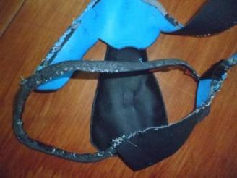
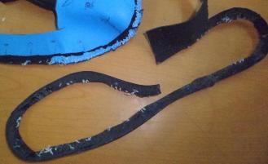
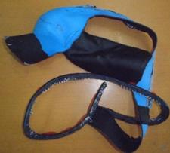
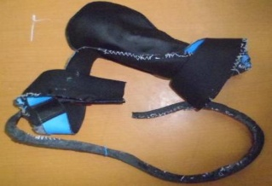
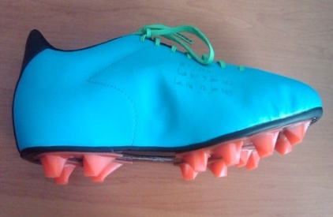
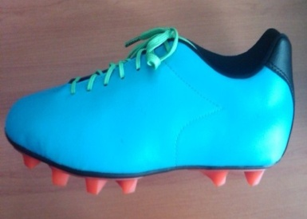
15SS Fortuna with Flash Activator
Product Trial & Bonding Test
NO | TEST TYPE | RESULT | REMARK | PICTURE
1 | Bonding test Fortuna | Pass | From 8 pcs – all Passed Bonding averages destruction more than 82% and averages Bonding is 42 N/CM (only 1 Failed – d/t pressing at 2 points failure but Bonding overall is Good
3 | Aging Test | Pass | Result 5 grade

Slide 8





Project Charter

